Slide 1
Name: Swapnil Ghosh
Dept: IT
Roll No: 001911001067
PROGRAM 2

Slide 2
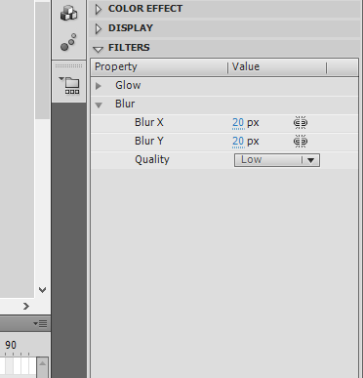
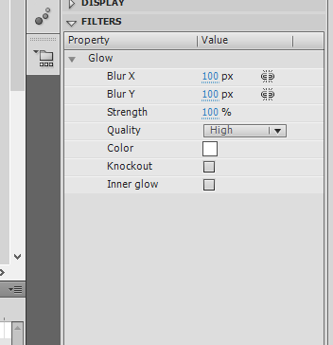

1. Open flash 8 software -> click on flash document->go to windows->properties
->select the properties tool-> choose the Background to black.
2. Go to fill color under tool bar-> select the white color.
3. Select the oval tool in order to draw the moon. u will get a white circle.
4. Select the oval tool in order to draw the moon. u will get a white circle.
5. Select the white circle on the worksheet using the selection tool->right click-
>convert to symbol->select movie clip->give suitable name eg: moon->click ok.
6. Go to filter->click on the + symbol->select glow to apply glowing effect-> select the color to white under glow and adjust the blur x/blur y values.

Slide 3
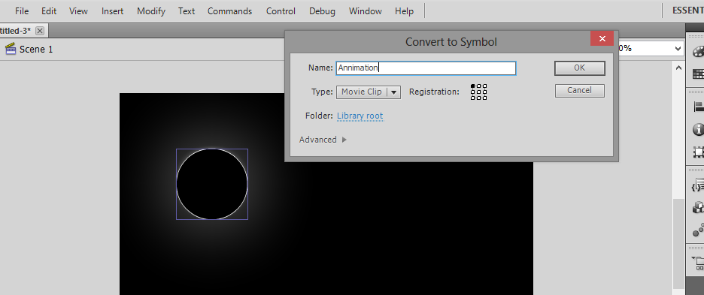
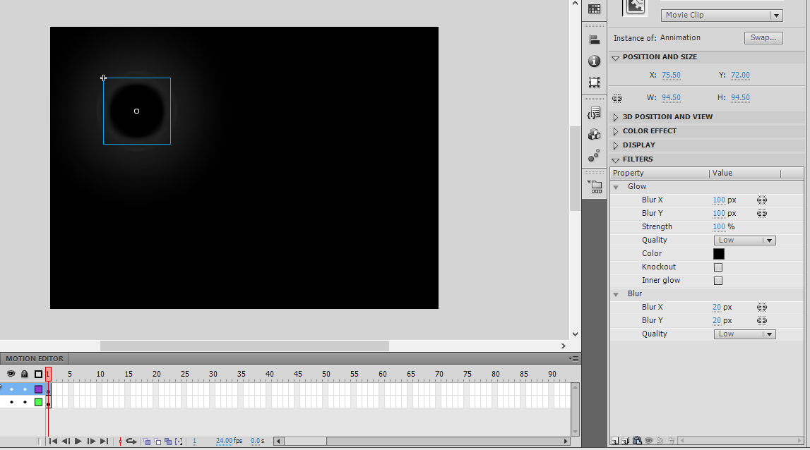
7. Click on the + symbol again and chose blur-> again adjust the blur x/blur y values.
8. Place the moon where ever you want on the work area.double click on layer 1 and rename as MOON.
9. Insert another layer->rename it as Animation.
10. Select the fill color to black-> select oval tool and draw a circle on the moon to cover the moon->select the newly added circle-> right click-> convert to symbol-> movie clip-> name it as Animation.
11. Go to filter-> select + symbol->give the glow and blur effect as did for moon.

Slide 4
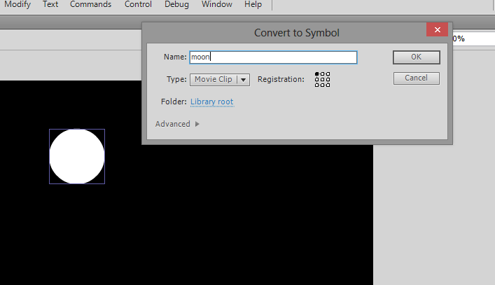
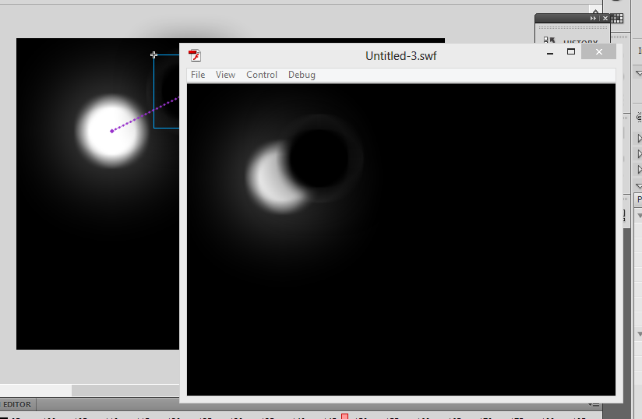
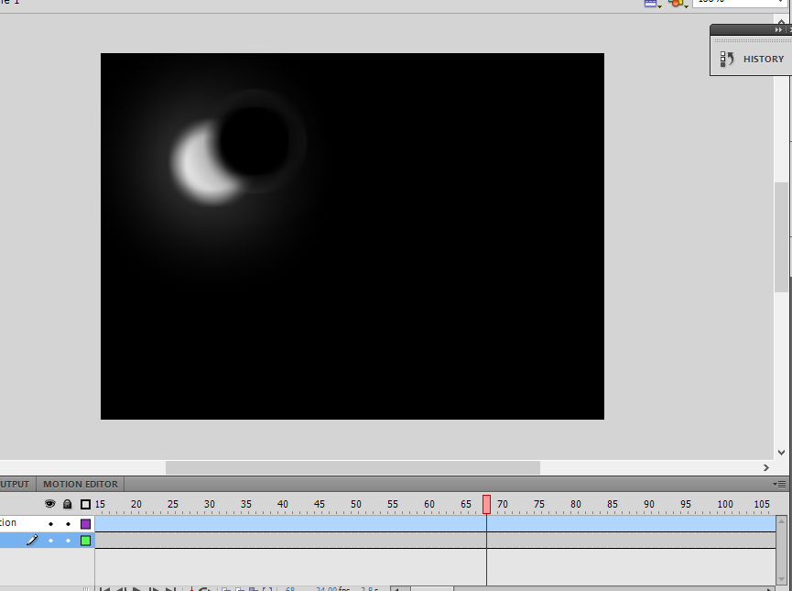
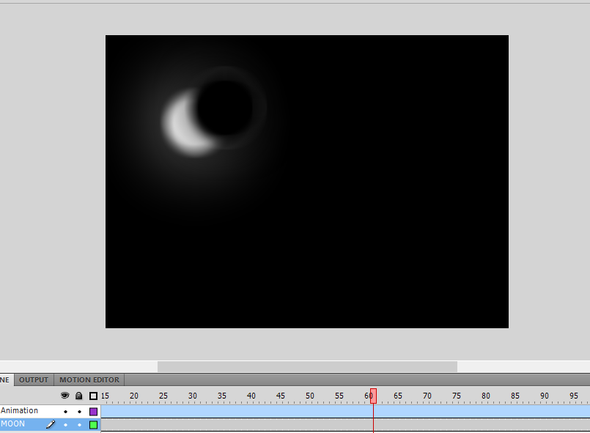
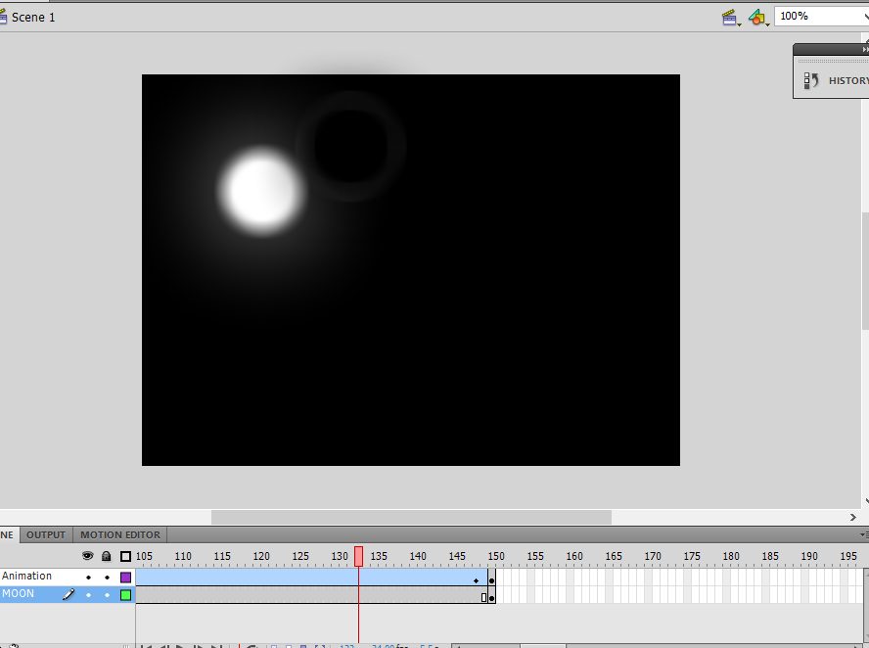
12. Select the 150th frame in moon layer->right click->insert key frame. repeat the same for Animation layer.
13. Click on the 149th keyframe of animation layer ->right click->press create motion-> select the animation movie clip and move slowly across the moon.
14. Finally go to control-> test movie-> u will get a growing moon as the output.

